Slide 1




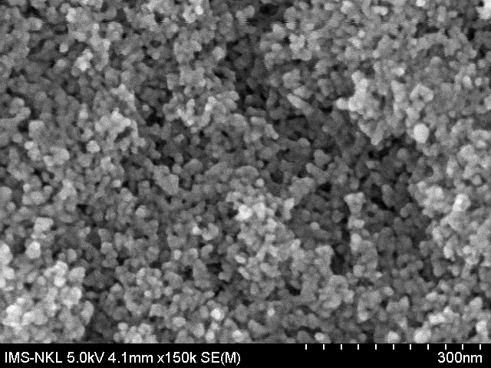
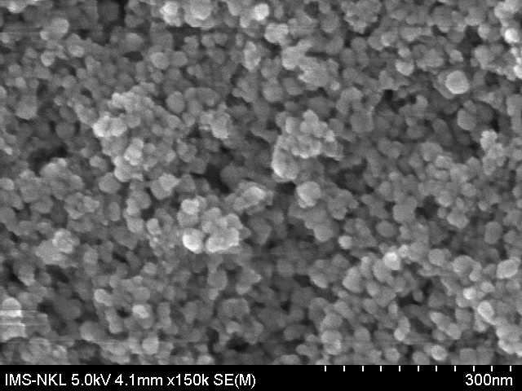
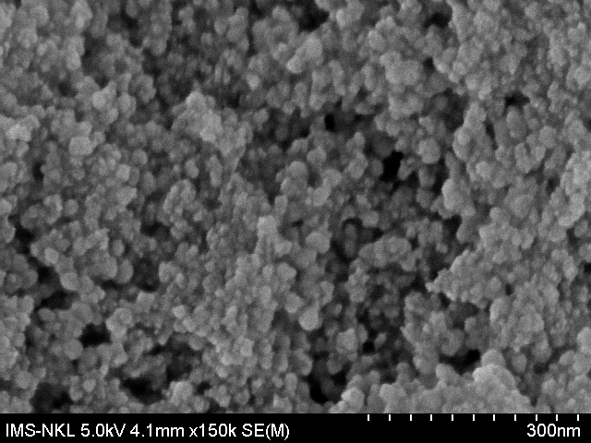
ICAMT 2024
INTERNATIONAL
CONFERENCE
ON ADVANCED MATERIALS AND TECHNOLOGY
Hanoi, Vietnam, October 09-12, 2024
POSTER CODE: A-XXX
INVESTIGATE THE PROPERTIES OF ZN₂SNO₄ MATERIALS AT DIFFERENT HYDROTHERMAL
TEMPERATURES FOR GAS SENSOR APPLICATION
Nguyen Hong Hanh, Lai Van Duy, Hoang Xuan Thanh, Nguyen Duc Hoa*
International Training Institute for Materials Science (ITIMS), Hanoi University of Science and Technology, No. 1, Dai Co Viet, Hai Ba Trung, Hanoi, Viet Nam.
*corresponding email : ndhoa@itims.edu.vn
INTRODUCTION
Motivation
Zn₂SnO₄ material
High electron mobility
Investigate the properties of Zn₂SnO₄ materials at different hydrothermal temperatures
Good uniformity
Applied Zn₂SnO₄ on gas sensor
High electrical conductivity
Measure the H₂S-sensing characteristics of Zn₂SnO₄ at different hydrothermal temperatures
EXPERIMENTAL
Poster size: A0
(a)
(b)
Fig. 3. H₂S-sensing characteristics of Zn₂SnO₄ at 180ºC/24h hydrothermal measured at different temperatures 350ºC, 400ºC, 450ºC : (a) transient resistance and sensor response versus time upon exposure to different H₂S concentrations, (b) sensor response as a function of H₂S concentrations.
Investigate the properties of Zn₂SnO₄ material at different hydrothermal temperatures: 180ºC/24h, 200ºC/24h, 220ºC/24h.
SEM, XRD measurement.
H₂S Sensing Properties of Zn₂SnO₄ material at different hydrothermal temperatures.
RESULTS AND DISCUSSIONS
Fig. 1. The SEM images of the synthesized Zn₂SnO₄.
(a)
(b)
Fig. 4. Sensor response as a function of H₂S concentrations 350ºC, 400ºC, 450ºC with (a) 200ºC/24h hydrothermal (ZTO_2), 220ºC/24h hydrothermal (ZTO_3).
(a)
180 ºC / 24 h
(b)
200 ºC / 24 h
(c)
220 ºC / 24 h
Fig. 2. The XRD images of the synthesized Zn₂SnO₄.
(a)
(c)
Fig. 5. Sensor response as a function of H₂S concentrations at 400ºC with 180ºC/24h hydrothermal (ZTO_1), 200ºC/24h hydrothermal (ZTO_2), 220ºC/24h hydrothermal (ZTO_3).
(b)
Fig.1, it is observed the SEM images of Zn₂SnO₄ material with different hydrothermal temperatures: (a) 180ºC/24h; (b) 200ºC/24h; (c) 220ºC/24h to demonstrate the Zn₂SnO₄ material are nanoparticles.
In the Fig. 2, the XRD images of Zn₂SnO₄ material. It demonstrate all 3 samples are Zn₂SnO₄ material. Especially, the 200ºC/24h sample with all pic are (311), (400), (511), (440), (622), (731) compare with Zn₂SnO₄ XRD standard.
In Fig. 3, 4, 5, we show the H₂S-sensing characteristics of Zn₂SnO₄ at different hydrothermal temperatures: 180ºC/24h, 200ºC/24h, 220ºC/24h were measured at different temperatures 350ºC, 400ºC, 450ºC, under different H₂S concentration from 1 ppm to 20 ppm. It showed that, the highest sensor response (S) at 400ºC with H₂S concentration from 5 ppm to 20 ppm.
CONCLUSIONS
By investigation the properties of Zn₂SnO₄ material at different hydrothermal temperatures: 180ºC/24h, 200ºC/24h, 220ºC/24h. We showed that Zn₂SnO₄ was the good material for the gas sensor applications.
Acknowledgment: This research was supported by the .......................................................................................................................................

